Slide 1
Billboard hits, a look behind the numbers
By Deepti Shandilya, Ava Prokop and Jason Garner
Notes:
INTRODUCTIONS!!!
-How many people enjoy listening to music?
-Does anyone not like music or know what music is?
-Do we have any musical artists in the crowd?
BILLBOARD = music industry standard record chart in the United States for songs, albums, etc.

Slide 2
Music through the years
1960’s:
Elvis
Beatles
TEMPATIONS
1970’s:
JACKSON 5
FOUR SEASONS
BEE GEES
1980’s:
Michael Jackson
Whitney Houston
Madonna
Notes:
-Show of hands about which decade of music most identify or connect with

Slide 3
Music through the years
1990’s:
Ace of Base
Boyz II Men
TLC
2000’s:
BEYONCE
USHER
KELLY CLARKSON
2010’s:
MAROON 5
THE CHAINSMOKERS
JUSTIN BIEBER

Slide 4
Generation vs generation
Notes:
How many have either said something like this or have been told something like this?
-Grandparents
-Parents
-Kids
-2 generations seems to be a higher incidence

Slide 5
Generation vs generation
2011
1975
Notes:
Beyonce vs Queen (Freddie Mercury)
Both fantastic and iconic artists
2 very popular and well known songs
From 2 completely separate generations

Slide 6
What makes them different?
Vs.
Notes:
-Is it a story set to music OR simple phrases set to music?
-Are song writers telling stories?

Slide 7
Original question
Do lyrics of current billboard hits have less unique words compared to previous years and decades?

Slide 8
Generation vs generation
2011
1975
UNIQUE WORDS = 10
UNIQUE WORDS = 87
Notes:
36 years apart
Difference of 77 unique words
Gross example to justify inquiry

Slide 9
Methods
Search for database of billboard hits per year
Ultimately created csv of billboard hits per year
Attempted to obtain lyrics from api seeds but difficulties with getting enough information through API
Pivot required with questions about billboard top 10 hits csv created

Slide 10
Three questions
1) What is the Percentage of artists that are one-hit-wonders vs those that have repeat hits
2) what is the Gender popularity in top 10 hit song titles
3) what is the Likelihood of solo artists vs groups/bands making a top 10 hit (avg / year)

Slide 11
Three hypotheses
Hypothesis 1: Artists/groups have less than a 10% chance of creating more than one Top 10 hit
Null Hypothesis 1: Artists/groups have greater than a 10% chance of creating more than one Top 10 hit
Hypothesis 2: Among the most popular song titles within top 10 hit song titles, the majority of them are about women
Null Hypothesis 2: Among the most popular song titles within top 10 hit song titles, the majority of them are about men
Hypothesis 3: The likelihood of solo artists making a top 10 hit is greater than the likelihood of of groups making a top 10 hit
Null Hypothesis 3: The likelihood of solo artists making a top 10 hit is less than the likelihood of of groups making a top 10 hit

Slide 12
One hit wonder?
Hypothesis #1:
The chance of any “artist,” whether a solo artist or a band consisting of multiple musicians, has less than a 10% chance of creating more than one hit that makes it to the Top 10 charts.
→ So the majority of hits are more commonly “one hit wonders,” and not performed by artists that have made it to the Top 10 charts in the past.
Notes:
AVA!!!

Slide 13
Results
What we found:
Hypotheses completely incorrect.
How Incorrect…?
We found that the Majority of hits on this list are actually by repeat artists, about 78% in fact. And only about 22% were hits that could be considered “One Hit Wonders.”

Slide 14
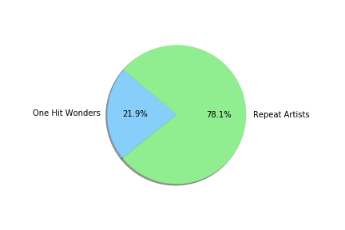
Winner = Repeat hits

Slide 15
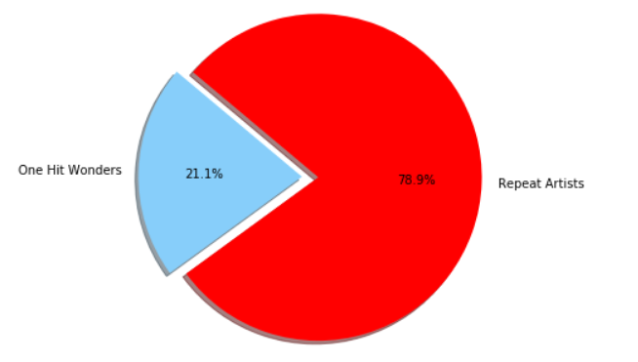
Intuitive Answer?
Does this ratio seem to represent your own personal music preferences?
Are the majority of the songs you listen to by artists you are very familiar with?

Slide 16
Additional hypothesis?
Even though they were a small percentage within the overall time period that we studied, Perhaps One-hit-wonders, on average, became more prevalent over time
Primarily because Individual hits Seemed to be replacing artists that garnered multiple hits due to a successful Album
as albums seem to carry less importance to consumers as the decades wear on

Slide 17
Male or female?
Hypothesis # 2:
Among the most popular song titles within top 10 hit song titles, the majority of them are about women
Female:
She, Queen, Woman, Women, Gal, Girl, Girls, Gurls, Chick, Lady, Ladies, Sister, Wife, Daughter
Male:
He, His, Man, Men, Boy, Boys, Guy, Gentlemen, Gentleman, King, Brother, Father, Son

Slide 18
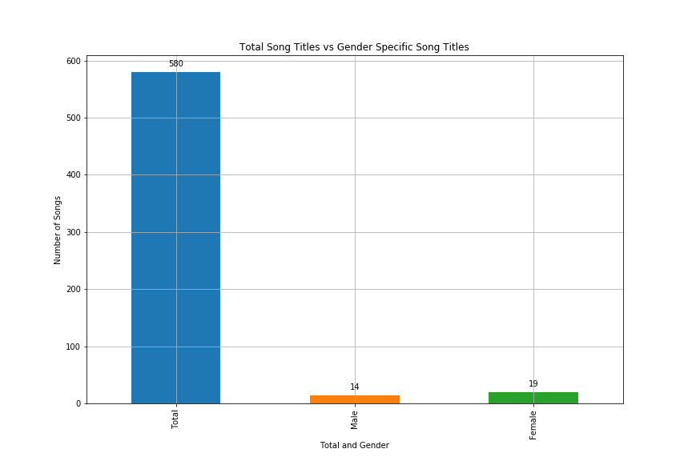
Winner = Females
Song Titles | Total Number | Percent of Songs
All Songs | 580 | 100.00%
Male Songs | 14 | 2.41%
Female Songs | 19 | 3.28%
Notes:
-DOES NOT MEAN SONG WAS NOT ABOUT A GENDER

Slide 19

Solo Artist or Group
Hypothesis # 3:
The likelihood of solo artists making a top 10 hit is greater than the likelihood of of groups making a top 10 hit

Slide 20
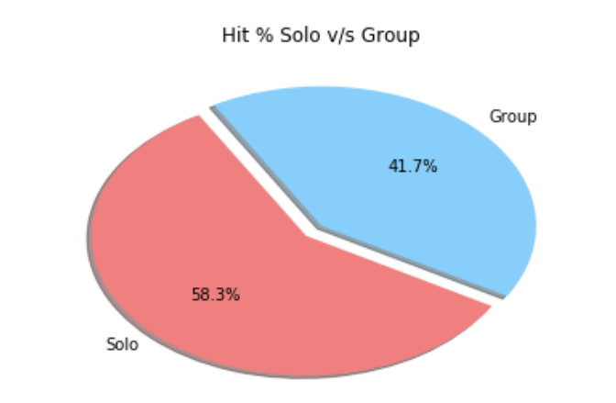
Winner = Solo
Solo | Group | Total
338 | 242 | 580
58% | 42 % | 100 %

Slide 21
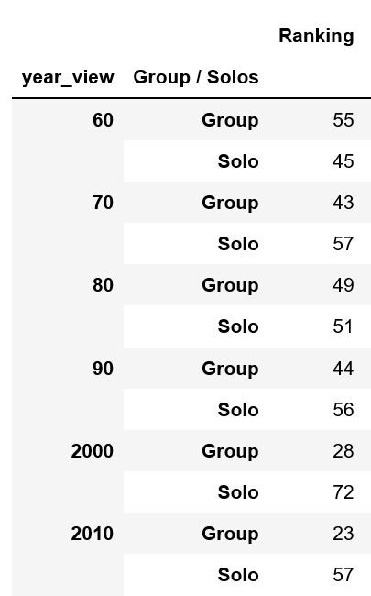
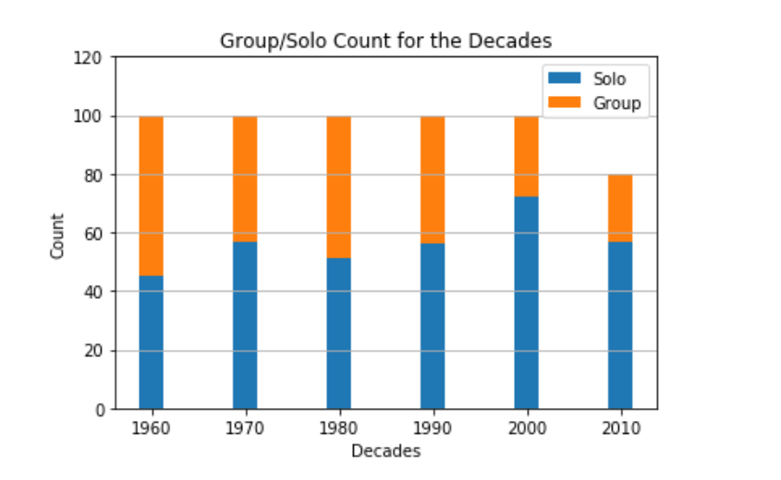
year wise winner (1960’s – 2017)

Slide 22
Summary of results
-in analyzing artists/groups with 1 hit vs repeated hits, it was found that 78.1% of the songs were artists/groups with multiple hits
-IN ANALYZING GENDER TRENDS IN SONG TITLES, IT WAS OBSERVED THAT FEMALE WORDS APPEARED IN 3.28% OF SONG TITLES AND MALES 2.41% OF SONG TITLES
-Analyzing the overall trends of hits(Solo v/s Group), it was observed that the solo artist are having higher hits than the group.
- Year’s for Solo songs were 1972 and 2008, all the hits were from Solo Artist.
- Group Songs had maximum of 8 hits(out of 10) in 1960’s(1965, 1966, 1967 and 1969).

